Slide 1
Project Bootcamp Program

Slide 2
Timelines
Date | Time | Task Description
01-10-2026 | 4 PM- 5PM | Project Kick-off Meeting
08-10-2026 | 4 PM- 5PM | Implementation of KPI’s using Excel
15-10-2026 | 4 PM- 5PM | Implementation of KPI’s using Tableau - Part I
22-10-2026 | 4 PM- 5PM | Implementation of KPI’s using Power BI – Part II
29-10-2026 | 4 PM- 5PM | Final Presentation of the Project/SQL queries

Slide 3
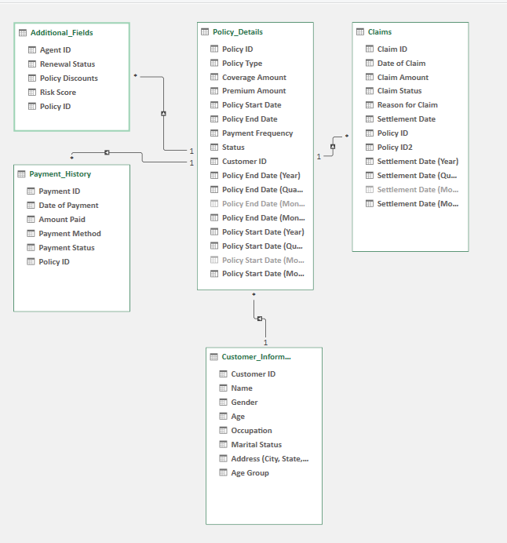
Excel file : Policy details

Slide 4
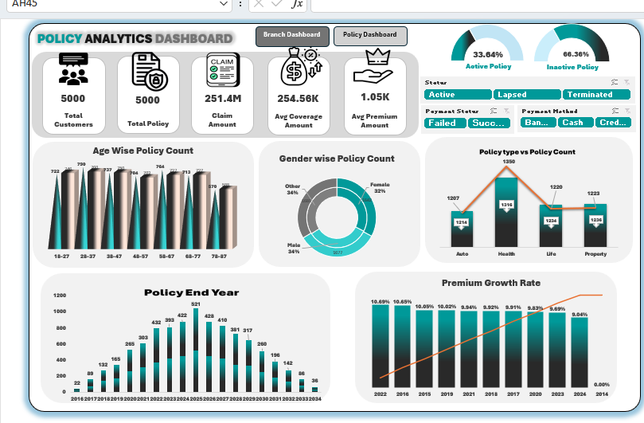
KPI’s

